Slide 1

Programming Principles
1811ICT/2807ICT/7001ICT
Week 2 Lecture
Dr Mardé Helbig

Slide 2

Workshops Week 2
Preparation
Go through Sections 1-4 on course site and recording of Lecture 1
Labs/Workshops
Online workshops have been split into different groups
Workshop covers work of previous week’s lecture
More examples than lecture
Learning to debug code!
Lab/workshop sheet released 2 weeks in advance
If you have any questions about setting up Python, ask in Workshop
Write down any questions you have about content in Sections 1-4
Complete the lab induction:
Two mandatory modules:
Emergency Response and Evacuation (Annual Fire Safety) Training
Health and Safety Induction
Learning by doing!
Can find Workshop information in Microsoft Teams channel Workshops or Labs

Slide 3
Input/output and variables
Section 5: print

Slide 4

print
Use print function in the standard library, Built-in Functions.
Name of function
Arguments of function
Keyworded arguments are optional
print(*objects, sep=’ ’, end=’\n’, file=sys.stdout, flush=False)
0 or more values to print
char put between objects in output
Whether to flush IO buffer to file after this output.
Default is False (no).
Default value is a space
Text placed after all objects
Default is new line (‘\n’)
File output is written to
Default is standard output (console)

Slide 5

Print statements
Demo in REPL:
$python
>>> print() #print a black line
>>> print(52) #print an int
52
>>> print(5.2) #print a float
5.2
>>> print(52, 5.2) #print two things
52 5.2
>>> print[]
File “<stdin>’, line 1
print[]
^^^^^^
SyntaxError: Missing parentheses in call to ‘print’. Did you mean print(…)?
# indicates a comment and stretches to end of line
Each line in demo is a call to print function
Each line in demo is a statement
In Python statements do not have to be terminated by semi-colon (;)

Slide 6

Print statements
Default: end=‘\n’ and sep=‘ ‘
Play around with changing those values
Demo in REPL:
$python
>>> print(52, end=‘,’)
52,>>>
>>> print(5.2, end=‘;’)
5.2;>>>
>>>print(52, 5.2, sep=‘:’)
52:5.2
>>>print(52, 5.2, 54, sep=‘:’)
52:5.2:54
>>> print(52, 5.2, 54, sep=‘:’, end=‘\\’)
52:5.2:54\>>>
>>> print(52, 5.2, 54, sep=‘\t’, end=‘\\’)
52 5.2 54\>>>
Demo in REPL (cont.):
>>> print(52, 5.2, 54)
52 5.2 54
>>> print(2, 4, 6, 8, sep=‘,’, end=‘.\n’)
2,4,6,8.
>>> print(2.567*3.89 + 2 – 8) #expressions
Dfasfd
>>> print(“hello”)
hello
>>> print(hello)

Slide 7

Any questions?
Type your question in the Q&A or raise your hand

Slide 8












Temperature Check
How do you feel about the print function?

Slide 9
Input/output and variables
Section 6: Variables

Slide 10

Variables
Demo in REPL:
$python
>>> a = 2
>>> b = 5.2
>>> a
2
>>> b
5.2
>>> a + b
7.2
How do we store values in Python?
Use variables!
Variables are references and their values are objects
How do we assign values to variables in Python?
Assignment operator (=)
Assign (bind) value on right to variable on left
Can recall value by calling name of variable

Slide 11

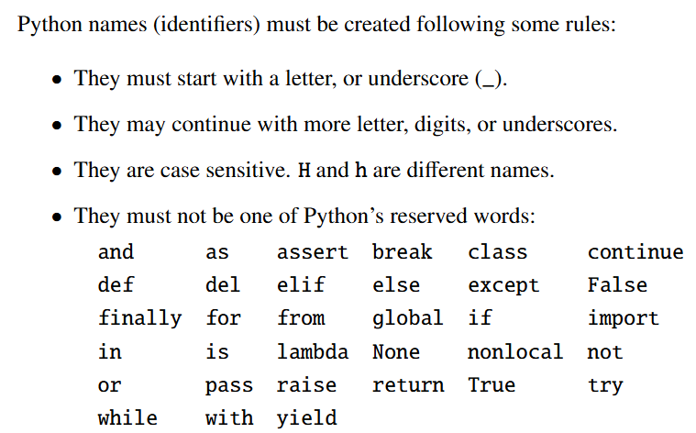
Variable names

Slide 12
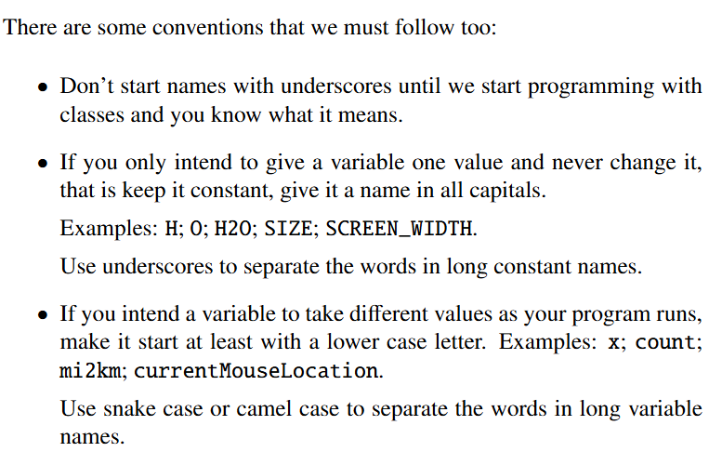
Variable names (cont.)

Slide 13
Variables – OO programming
Demo in REPL:
$python
>>> a = 2
>>> b = 5.2
>>> a
2
>>> b
5.2
>>> a + b
7.2
How do we store values in Python?
Use variables!
Variables are references and their values are objects
How do we assign values to variables in Python?
Assignment operator (=)
Assign (bind) value on right to variable on left
Can recall value by calling name of variable

Slide 14
Variables – OO programming
Class: data type defining the properties for any objects that are instances of this class
Objects:
Object: a specific instance of a class; stores values in memory
Can have many instances of one class
Reference: value that identifies a specific object in memory
What is the difference between value and type?
Demo in REPL:
$python
>>> a = 2
>>> b = 5.2
>>> type(a)
class<‘int’>
>>> id(a)
140725583215064
Values are objects; objects’ types are classes
We know how to find out the type of an object
How do we find out the reference of an object?
id function

Slide 15
Variables – OO programming
b: float
Demo in REPL:
$python
>>> a = 2
>>> b = 5.2
>>> type(a)
class<‘int’>
>>> id(a)
140725583215064
>>> id(b)
2726973058032
5.2
reference
Object b with type float, stored at memory location starting with 2726973058032, contains value 5.2
Object b at location 2726973058032 is an instance of class float and contains a value of 5.2

Slide 16
Variables – OO programming
Demo in REPL:
$python
>>> a = 2
>>> b = 5.2
>>> type(a)
class<‘int’>
>>> id(a)
140725583215064
>>> id(b)
2726973058032
Variable name b labels a reference which contains the memory location of the instance of class int that contains the value 42
object: float
reference
5.2
b
2726973058032
2726973058032
Actual reference (memory location) will be different every time you run this program
object: float
reference
5.2
b

Slide 17
Variables – OO programming
reference
object: int
Demo in REPL:
$python
>>> a = 2
>>> b = 5.2
>>> type(a)
class<‘int’>
>>> id(a)
140725583215064
>>> id(b)
2726973058032
>>> a = b
>>> a
5.2
>>> id(a)
2726973058032
2
a
reference
object: float
5.2
b
reference
object: int
2
a
object: float
reference
5.2
b

Slide 18
Variables – immutable objects
Demo in REPL:
$python
>>> a = 2
>>> b = 5.2
>>> type(a)
class<‘int’>
>>> type(b)
class<‘float’>
Mutable objects’ values can change
Immutable objects’ values cannot change
int and float: reference can change but values cannot => immutable
Simple types in Python are immutable
Will learn more complex types that are mutable
What does this mean for the example code?
object: float
reference
5.2
b

Slide 19
Variables – object Types
Languages that are compiled like C++ and Java:
Each variable has just one type
Statically typed at compile time
In Python (like JavaScript), variables are just names for references => types belong to objects/values
Interpretive languages are often dynamically typed => types of variables are bound at run time and can
change
Demo in REPL:
$python
>>> a = 2
>>> b = 5.2
>>> type(a)
class<‘int’>
>>> type(b)
class<‘float’>
What does this mean for the example code?
reference
object: float
5.2
b

Slide 20
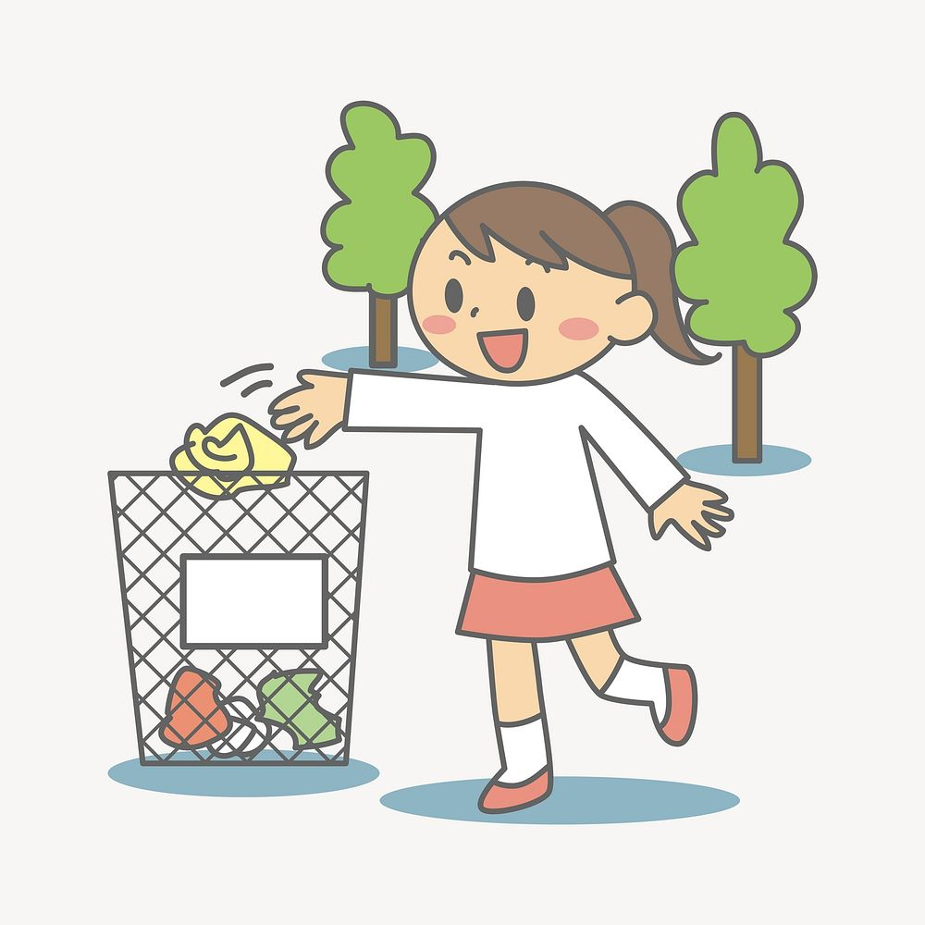
Garbage collection
Demo in REPL:
$python
>>> a = 2
>>> b = 5.2
>>> type(a)
class<‘int’>
>>> type(b)
class<‘float’>
>>> a = b
Objects and other data structures that are no longer needed are called Garbage
If no references point to an object the program can no longer use them
Python interpreter may safely remove them in a process called garbage collection
reference
object: int
2
a
reference
object: float
5.2
b

Slide 21
Deleting variables
Demo in REPL:
$python
>>> a = 2
>>> b = 5.2
>>> type(a)
class<‘int’>
>>> type(b)
class<‘float’>
>>> a = b
>>> del a
>>> a
Traceback (most recent call last):
File “<stdin>”, line 1 in <module>
NameError: name ‘a’ is not defined
>>> b
5.2
>>> id(b)
2726973058032
Variables no longer needed may be forgotten and deleted
Deleting the variable with del deletes the reference
It will not affect other variables that reference the same object
reference
object: int
2
a
reference
object: float
5.2
b
What happens if we refer to a deleted variable?

Slide 22

Any questions?
Type your question in the Q&A or raise your hand

Slide 23
Temperature Check
How do you feel about variables?

Slide 24

5 Minute Break Time!

Slide 25
Input/output and variables
Section 7: Strings

Slide 26

Strings
Python uses the str data type to represent characters and text
Most languages have separate types for a single character and a string (e.g. char and String in Java) => Python has just one type
Characters in Python strings are Unicode characters

Slide 27
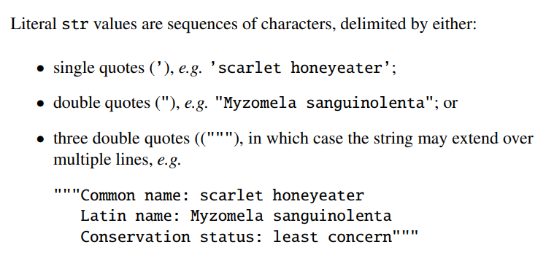
String literals

Slide 28
String variables
Demo in REPL:
$python
>>> h = ‘Harry Potter’
>>> h
‘Harry Potter’
>>> type(h)
class<‘str’>
Can assign string values to variables exactly the same way as with numbers
Most languages have separate types for a single character and a string (e.g. char and String in Java) => Python has just one type
Characters in Python strings are Unicode characters
object: str
reference
‘Harry Potter’
h

Slide 29
Printing strings
Demo in REPL:
$python
>>> coffee = 5.5
>>> print(“Price of coffee: “, coffee)
Price of coffee: 5.5
>>> print(“Price of two coffees: “, coffee*2)
Price of two coffees: 11.0
String values are printed just like numbers
Often print strings and numbers together

Slide 30
JOINING strings
Demo in REPL:
$python
>>> h = ‘Harry’
>>> h
‘Harry’
>>> id(h)
2726976662592
>>> h = h + ‘ Potter’
>>> h
‘Harry Potter’
>>> id(h)
2726978070192
The + operator creates a new object
The reference changed
str object is immutable

Slide 31
Any questions?
Type your question in the Q&A or raise your hand

Slide 32
Temperature Check
How do you feel about strings?

Slide 33
Input/output and variables
Section 8: prompts

Slide 34
Prompt a user
Demo in REPL:
$python
>>> h = ‘Harry’
>>> h
‘Harry’
>>> id(h)
2726976662592
>>> h = h + ‘ Potter’
>>> h
‘Harry Potter’
>>> id(h)
2726978070192
So far, we used the REPL as a calculator or printing values
But how can we ask a user for a value, i.e. prompt the user?
Imagine solving this problem in Python:
Write a program that asks for a value and then prints that number to the power of 3

Slide 35
Prompt a user
Imagine solving this problem in Python:
Write a program that asks for a value and then prints that number to the power of 3
Do we have enough information to solve this?
What should the output look like?
Suppose the answer is:
Enter a number: 2
The number to the power of 3 = 8.0
What can we infer from this information?

Slide 36
Decomposing problem
Imagine solving this problem in Python:
Write a program that asks for a value and then prints that number to the power of 3
Suppose the answer is:
Enter a number: 2
The number to the power of 3 = 8.0
We can now design a solution to the problem by specifying what should happen, in the correct order:
Print ‘Enter a number:’
Read the number entered by the user.
Print ‘The number to the power of 3=‘.
Print the number to the power of 3.
We know how to print, but how do we read a value?
Demo approach

Slide 37
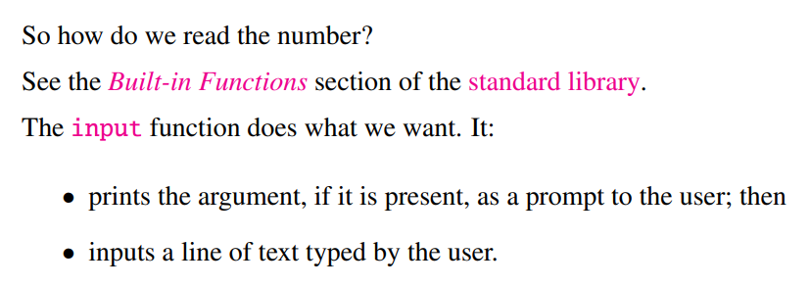
Decomposing problem
Imagine solving this problem in Python:
Write a program that asks for a value and then prints that number to the power of 3
Suppose the answer is:
Enter a number: 2
The number to the power of 3 = 8.0
We know how to print, but how do we read a value?

Slide 38
Prompt a user
Imagine solving this problem in Python:
Write a program that asks for a value and then prints that number to the power of 3
Demo in REPL:
$python
>>> input(‘Enter a number:’)
Enter a number: 2
‘2’
>>> x = input(‘Enter a number:’) #need a variable
Enter a number: 2
>>> print(‘The number to the power of 3 = ‘, x**3)
Traceback (most recent call last):
File “<stdin>”, line 1, in <module>
TypeError: unsupported operand type(s) for ** or pow(): ‘str’ and ‘int’
>>> print(‘The number to the power of 3 = ‘, float(x)**3)
The number to the power of 3 = 8.0
>>> y = float(input(‘Enter a number:’))
Enter a number: 2
>>> print(‘The number to the power of 3 = ‘, y**3)
The number to the power of 3 = 8.0
Suppose the answer is:
Enter a number: 2
The number to the power of 3 = 8.0

Slide 39
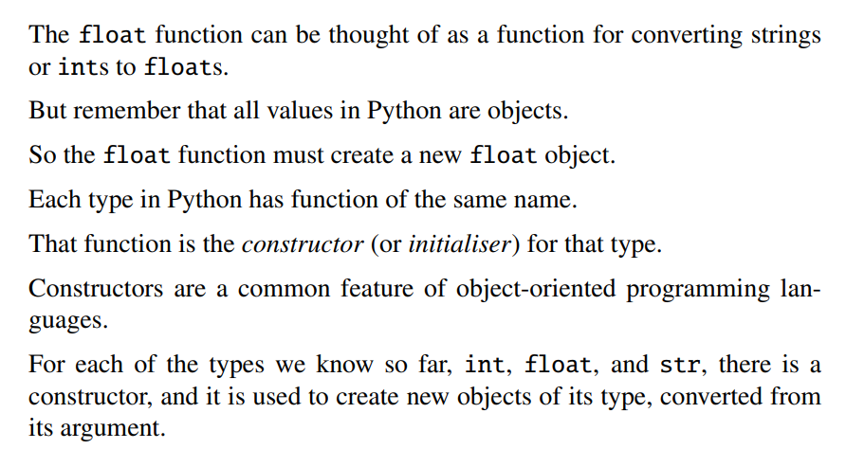
Constructors as converters

Slide 40
Temperature Check
How do you feel about prompts?

Slide 41
Any questions?
Type your question in the Q&A or raise your hand

